Slide 1

LLM Ecosystems:
From Foundations to Frontiers
ACSPRI Summer Program 2026 Dr. Maria Prokofieva

Slide 2


Why Do LLMs Matter in Social Science?
LLMs scale human-level language understanding
Applications include policy, legal analysis, qualitative coding
Academic access is now feasible — no longer just for Big Tech
They reduce cost + time for text-heavy workflows
They can analyze millions of words — reports, interviews, articles — with nuanced pattern recognition that mimics expert judgment at scale.
LLMs are already used to monitor citizen sentiment, identify emerging legal themes, cluster qualitative survey data, and flag ethical risks in reports.
Open-weight models and APIs (like Hugging Face, OpenAI, Gemini) now allow researchers to apply cutting-edge models with minimal infrastructure.
Manual coding, thematic tagging, or policy trend analysis that once took weeks can now be done in hours using reproducible, scriptable methods.

Slide 3

Machine learning models trained on billions of words
Work via token prediction, not memorization
What is an LLM?
Understand and generate human-like text
Used via APIs or code
Can summarize, classify, extract, and generate
Not perfect, but powerful and improving
Notes:
“Let’s begin with the basics — what exactly is an LLM?”
🔹 “LLM stands for Large Language Model. These are advanced machine learning models trained on billions of words — from books, websites, research papers, code, and more.”
🔹 “Unlike a database, they don’t memorize facts. They predict the most likely next word or token, based on context. So when you ask a question, they’re essentially constructing a response on the fly — word by word.”
🔹 “They’ve been designed to understand and generate human-like text — which is why they can write emails, summarize reports, and even translate languages.”
🔹 “You’ll often hear terms like summarize, classify, extract, generate. These are core capabilities — and they map directly to the kinds of text-based tasks we do in social science and government work.”
🔹 “Importantly, you don’t ‘install’ these models like software — they’re usually accessed via APIs or inside tools like Colab, OpenAI Playground, or Gemini.”
🔹 “And finally, while they’re not perfect — they are incredibly powerful, and improving rapidly. Which is exactly why we’re here: to learn how to harness them safely, creatively, and strategically.”

Slide 4
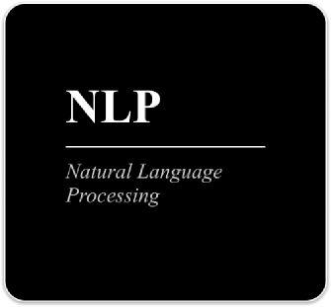



LLMs Power Text Analysis
Auto-code interviews or survey responses
Summarize long documents for policymaking
Detect sentiment shifts across large datasets
Classify thousands of news articles in minutes

Slide 5
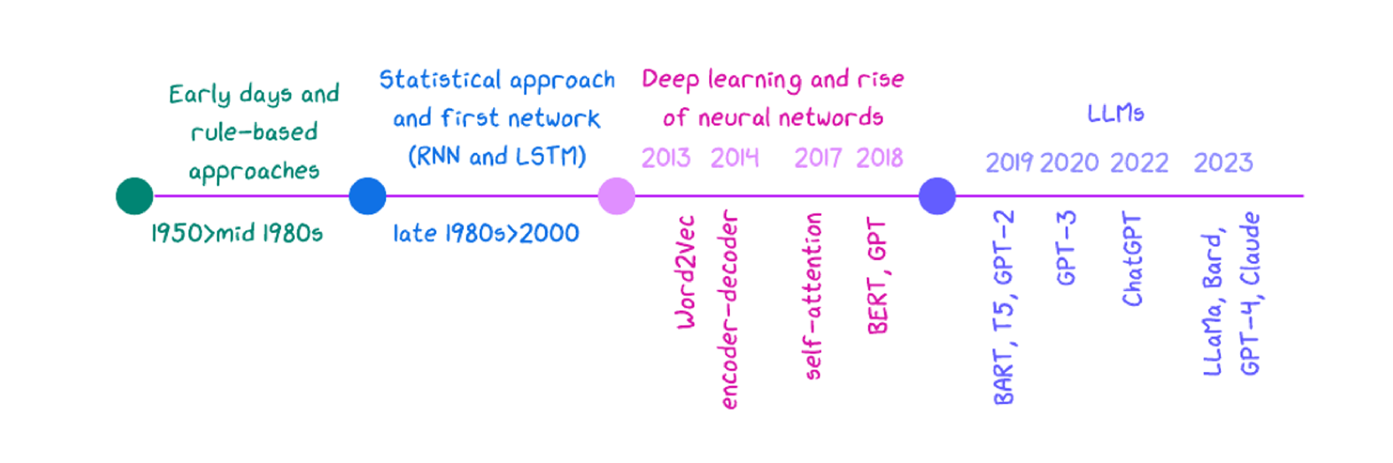
The LLM Timeline
Notes:
1. Early Days of NLP:
•1950s-1980s: Rule-based systems and symbolic AI. Early methods relied on handcrafted rules and simple statistical models.
•Limitations: Limited scalability, difficulty in handling complex language nuances, and high dependency on domain-specific knowledge.
2. Statistical NLP:
•1990s-2000s: Introduction of probabilistic models like Hidden Markov Models (HMMs) and Statistical Machine Translation (SMT).
•Shift to Data-Driven Approaches: Emphasis on using large text corpora for training models.
•Limitations: Still struggled with context, polysemy (multiple meanings of words), and long-range dependencies.
3. Neural Networks and Deep Learning:
•2010s: The rise of deep learning brought models like Word2Vec, which learned word embeddings capturing semantic meaning.
•Recurrent Neural Networks (RNNs) and LSTMs: Improved handling of sequences but were still limited by the vanishing gradient problem.
•Attention Mechanisms: Introduced in models like Transformers, enabling the handling of long-range dependencies more effectively.
4. The Transformer Revolution:
•2017: Introduction of the Transformer model by Vaswani et al., which replaced RNNs with self-attention mechanisms.
•Why Transformers? They allow for parallelization, better handling of context, and scalability in training large datasets.
•Birth of Pre-trained Models: Models like BERT, GPT, and T5 emerged, pre-trained on vast amounts of data and fine-tuned for specific tasks.
5. Emergence of Large Language Models (LLMs):
•2020s: LLMs like GPT-3, GPT-4, BERT, and others grew in scale, trained on billions of parameters.
•Why LLMs?
•Contextual Understanding: LLMs can capture nuanced meanings and context over long text sequences.
•Few-shot/Zero-shot Learning: Ability to perform tasks with minimal or no specific training data.
•Versatility: LLMs can be applied across diverse NLP tasks, from translation to summarization and beyond.

Slide 6

📚 Trained on billions of words
📚 Predicts tokens, not retrieves facts
How Do LLMs Actually Work?
Ingests books, articles, websites — huge corpus
Generates next word based on probability
🧠 Uses transformer architecture
🧾 Understands context in chunks (context window)
“Attention” lets model focus on relevant input
But not global memory — limited to recent input

Slide 7
Principles
Self-Attention
Positional Encoding
Transformer Block
Key idea: understand word relevance across a sequence
Composed of dense layers + normalization + residual paths, and stacked deep
Inject structure into unordered tokens
Notes:
PrincipleDescription
🧠 Self-Attention
Lets the model “look around” the entire sentence and determine which words are most relevant to each other. Critical for disambiguating meaning across long-range dependencies.
🔢 Positional Encoding
Since the model doesn’t process words in order like humans, this encodes the position of each token using math (sine/cosine) so the model knows the difference between “The cat sat” and “Sat the cat.”
🏗️ Transformer Block: Feedforward + Normalization + Depth
Each token passes through a small neural network, followed by normalization and residual connections (like scaffolding). These blocks are stacked — GPT-3 uses 96 of them — giving the model deep representational power.

Slide 8



Major Types of LLM Models
Encoder-only
Decoder-only
Encoder–Decoder (Seq2Seq)
Goal: Understand input text deeply
What it does: Reads the full input and builds a contextual representation
Popular examples: BERT, RoBERTa, DistilBERT
Used for:
Text classification
Named Entity Recognition
Sentence similarity No text generation
Goal: Generate fluent text from left to right
What it does: Predicts one token at a time based on previous tokens
Popular examples: GPT-2, GPT-3, GPT-4, Claude, Gemini
Used for:
Chatbots
Text generation
Summarization These models don’t "see" the entire input at once — they build it as they go.
Goal: Transform one sequence into another
What it does: Encoder reads the full input
Decoder generates output
Popular examples: T5, FLAN-T5, BART, mT5
Used for:
Translation
Text summarization
Question answering They’re the most flexible, but more complex.

Slide 9
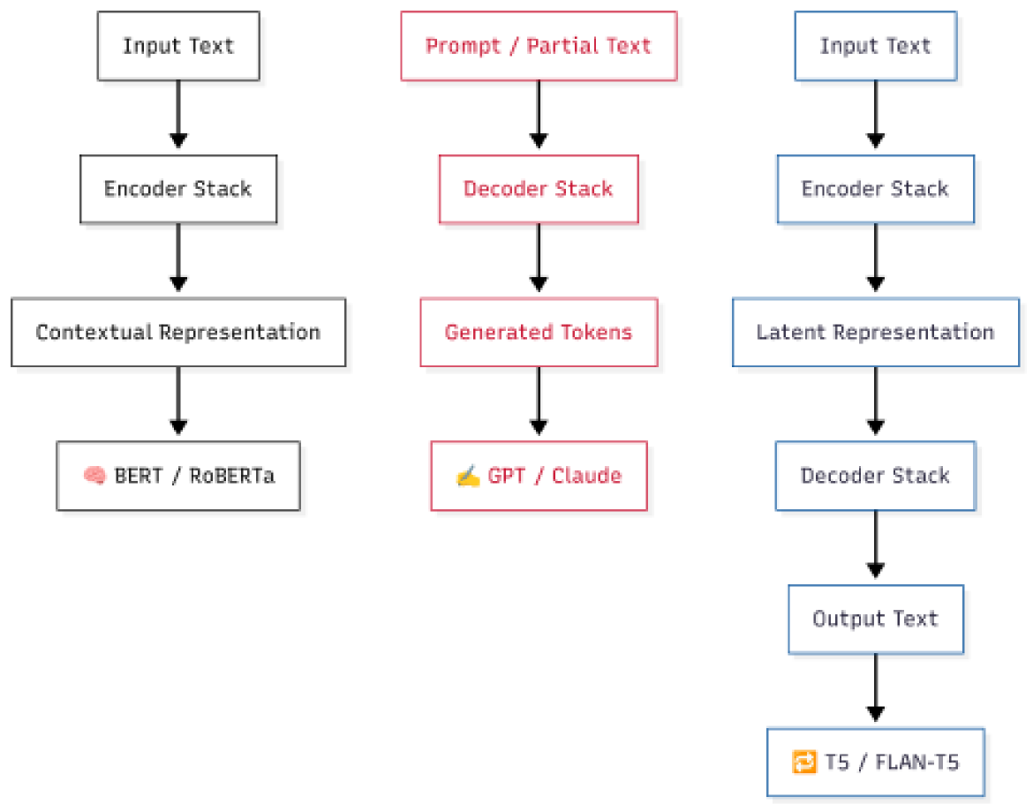
Major Types of LLM Models

Slide 10
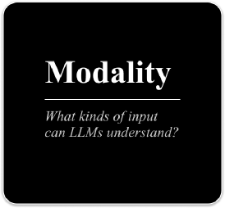
Modalities in LLMs
📝 Text
🖼️ Image
🔊 Audio
Natural Language input/output
Visual input: images/photos
Voice/sound input/output
🎥 Video
🌍 Multilingual
📊 Structured Data
Moving sequences
Cross-lingual understanding
Tables, JSON, code
Notes:
“A modality refers to the type of data a model can process — like plain text, images, audio, structured tables, or even video.
Some models handle just one — these are unimodal. Others are built to handle multiple types — these are multimodal.”
“This distinction isn’t just semantic — it fundamentally changes the model’s architecture and what it can do.”

Slide 11
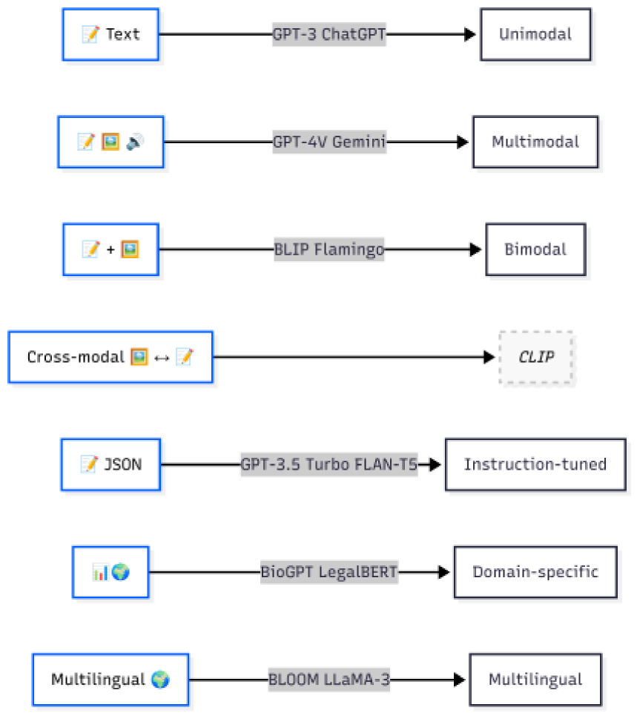
How Modalities Map to Model Types
Notes:
“Unimodal models like GPT-3 are optimized for token-level prediction in plain text. They’re fast, clean, and ideal for classic NLP tasks like summarisation or classification.”
“Multimodal models, like GPT-4V or Gemini, include additional input pathways — for example, image encoders — and a fusion layer that allows them to reason across modalities. These are essential for tasks like answering questions about a chart, a scanned PDF, or even a photo.”
“Bimodal and cross-modal models are even more specialized — they match one input type to another, like generating a caption from an image or retrieving the best image for a sentence.”
“Instruction-tuned models, regardless of modality, are built to follow natural-language commands — and they thrive on JSON, survey outputs, or prompt chains.”
“So if you’re coding interviews — unimodal is enough. But if you’re analyzing public sentiment from TikTok clips or combining image + text in a field report, you’ll need multimodal architecture.”
“Understanding how modality shapes model type helps you make smart, fit-for-purpose decisions — whether you're deploying a chatbot, building a pipeline, or evaluating tools for your team.”

Slide 12



Foundational vs Proprietary Models
Foundational Models
Proprietary Models
Trained on broad, general-purpose datasets (e.g. Common Crawl, Wikipedia, books)
Released as base models.
Examples: LLaMA 3, Mistral, Falcon.
Developed by private companies
High performance, but API-only access
Customization often limited.
Examples: GPT-4, Gemini, Claude.

Slide 13
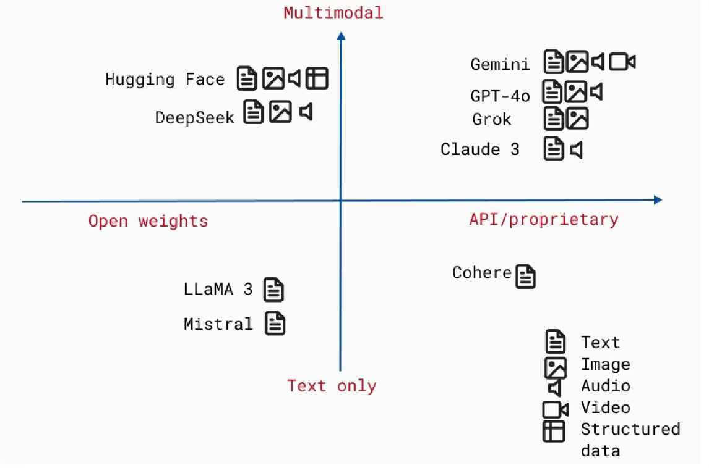
Model Families Landscape

Slide 14

Model= Architecture + Weights
What Makes a Model Work?
Architecture gives structure.
Weights give skill.
Architecture
Weights
Blueprint: How many layers, what type, how they connect
Defines how:
data flows through the model
data patterns can be learned
Architecture choice determines if a model can handle images (CNNs) or text (transformers).
Learned values: What the model knows after training
Numerical values (e.g., 0.347, -1.892) that scale input data.
Weights determine if a model actually works well for your specific task.

Slide 15

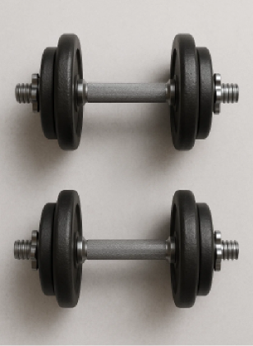
Weights are not released — only accessible via API.
Training data is undisclosed .
Model architecture may not disclosed.
Fine-tuning access is limited or expensive.
Usage tracking + safety layers often run in the background.
Proprietary Models: What You Don’t Get to See
Understanding the hidden layers behind closed-source LLMs

Slide 16


Numerical values
Not "knowledge"
Parameters are the that define how a neural network processes input data to produce output.
That's the weights and patterns formed by parameters during training.
Parameters
What does a trillion-parameter model actually mean?
Not "rules"
Not fixed
The model has no explicit logic—just math.
They change during training via optimization.

Slide 17




What Parameters Actually Do
Transform Input Data
Enable Learning
Dictate Model Behavior
Every input (text, image, etc.) is converted to numbers (vectors).
Parameters are the coefficients in the functions that:
Scale (weight),
Shift (bias), or
Gate (attention) these numbers.
During training, parameters are adjusted via:
Loss calculation: How wrong the model's output is.
Gradient descent: Tweaking parameters to reduce loss.
The arrangement and values of parameters determine:
Capacity: Can it memorize complex patterns?
Generalization: Can it apply patterns to new data?
📦 Parameters = the knobs, levers, and memory of a model. They shape how input becomes output — and how models evolve.

Slide 18

Downloadable model weights
Training data (usually unreleased or partially described)
What Does “Open Weights” Actually Mean?
Ability to run/fine-tune locally
Full license to deploy commercially (varies by model)
Open Weights ≠ Full Openness
Architecture details (often published)
Tokenizers, eval metrics, or guardrails often separate

Slide 19

Does Bigger = Better?
More parameters ≠ better results — unless trained well and aligned to the right task.
Memorization vs Generalization
🧠 Bigger ≠ Smarter
Large models can memorize training data if not trained properly — making them brittle or biased.
Example: A poorly trained 70B model might repeat toxic forum posts instead of understanding nuance in a new context.
Finetuned > Gigantic
🎯 Smaller + Targeted = Better
A smaller model, finetuned on clinical trials, can outperform GPT-4 on biomedical summarization.
Example: BioGPT or a custom Gemini finetune often beats generic LLMs in specialized settings.
Cost Reality
💰 More Params = More Compute = More $$$
Every billion parameters adds cost — for both training and inference.
Example: GPT-4-turbo is cheaper than GPT-4 because it optimizes how those parameters are used — not because it’s smaller.

Slide 20

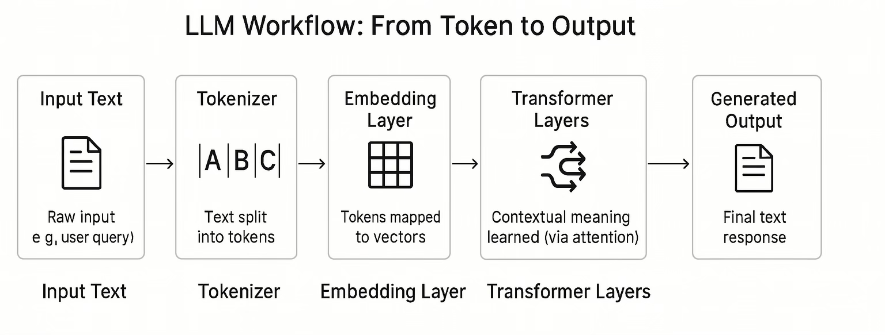
Preview — From Parameters to Meaning (Day 2)
“The model doesn’t just generate text. It learns to position language in space.”

